Slide 1
I N T E R N E T

Slide 2
Session Objective
What is INTERNET ?
Brief History of Internet.
Services provided by Internet.
Impact of Internet.
  Education.
  Health Care.
  Business.

Slide 3
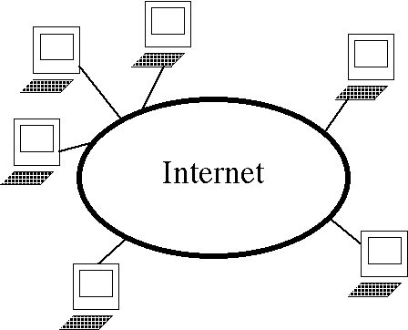
What is I N T E R N E T ?
The largest network of networks in the world.

Slide 4
What is I N T E R N E T ?
Continue……
A network of networks, joining many government, university and private computers together and providing an infrastructure for the use of E-mail, bulletin boards, file archives, hypertext documents, databases and other computational resources.

Slide 5
What is I N T E R N E T ?
Continue……
The vast collection of computer networks which form and act as a single huge network for transport of data and messages across distances which can be anywhere from the same office to anywhere in the world.

Slide 6
Brief History of Internet
ARPA – Advanced Research Project Agency.
1969 January 2 – started an experimental Computer Network.
Concept – No Server, but equal importance/participation to every computer in the Network.
Even if, one or two node destroyed that will not affect the Network.

Slide 7
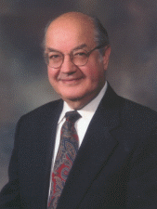
Paul Baran
Paul Baran developed the field of packet switching networks while conducting research at the historic RAND organization.

Slide 8

Vinton Cerf
Father of Internet
Co-designer of the TCP/IP networking protocol.

Slide 9
Brief History of Internet
Continue……
First named as ARPANET
This is renamed as INTERNET
  TCP/IP (Transmission Control Protocol/Internet Protocol)

Slide 10
Internet Growth Trends
1977: 111 hosts on Internet
1981: 213 hosts
1983: 562 hosts
1984: 1,000 hosts
1986: 5,000 hosts
1987: 10,000 hosts
1989: 100,000 hosts
1992: 1,000,000 hosts
2001: 150 – 175 million hosts
2002: over 200 million hosts
By 2020, about 80% of the planet will be on the Internet

Slide 11
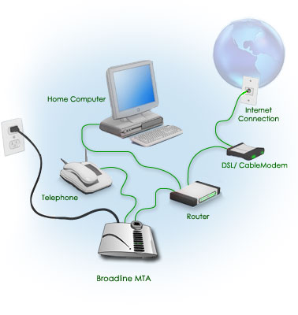
How to Connect to Internet

Slide 12
Internet Services
Electronic Mail (e-mail)
World Wide Web
Telnet
File Transfer Protocol (FTP)
Internet Telephone
Web TV/Radio
Internet Relay Chat
News Groups

Slide 13
Electronic Mail (e-Mail)
Distributes e-mail messages and attached files to one or more electronic mailboxes.
Eg:- e-mail addresses
  thomas@mes.edu.in
  murugan@mesmarampally.org

Slide 14
Electronic Mail (e-Mail)
Continue……
  thomas @ mes . edu . in
  murugan @ mesmarampally . org
Name of Person
Organization
Type of Organization
Country

Slide 15
Electronic Mail (e-Mail)
Continue……
Different e-mail service providers
  G-Mail
  Yahoo Mail
  Hot Mail

Slide 16
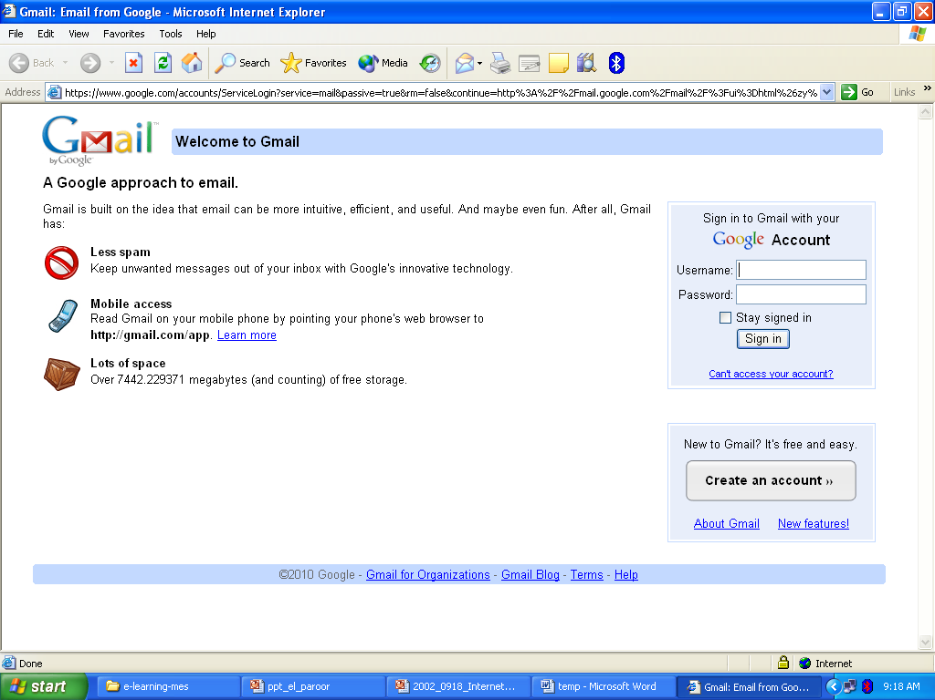

Slide 17
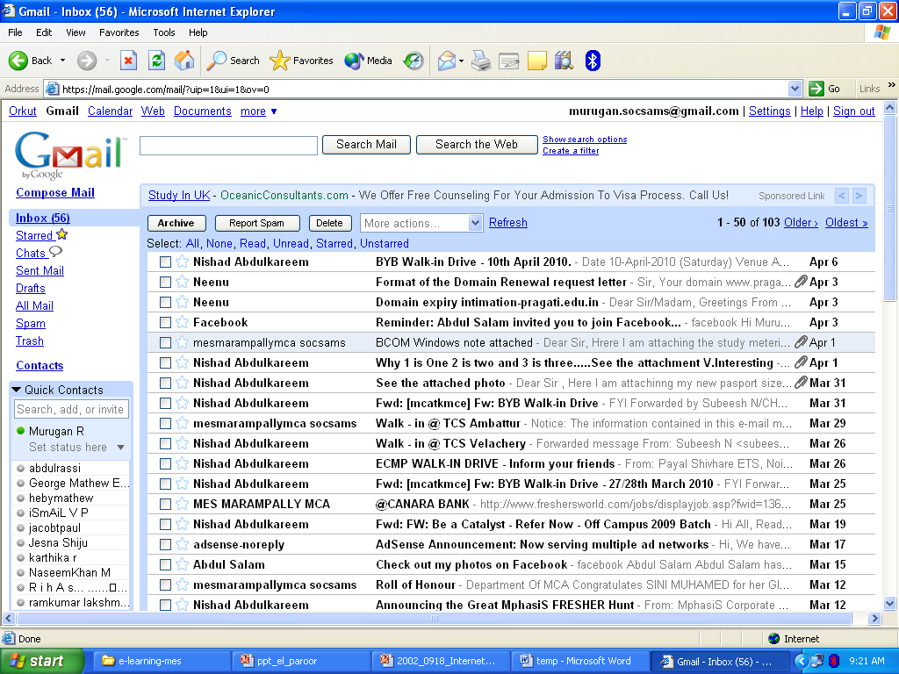

Slide 18
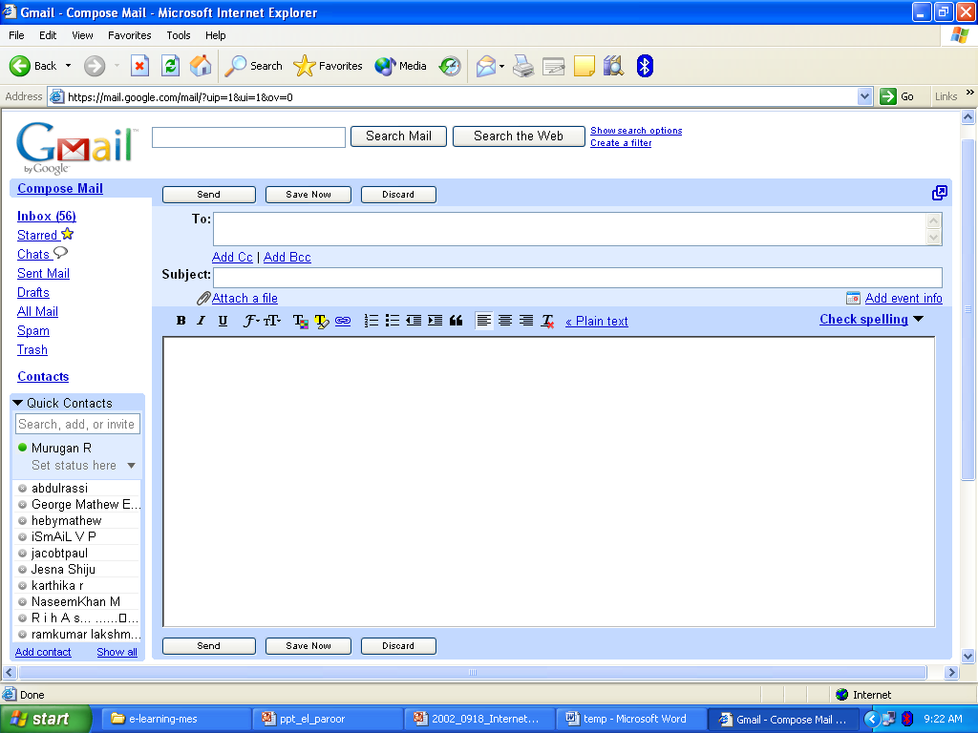

Slide 19
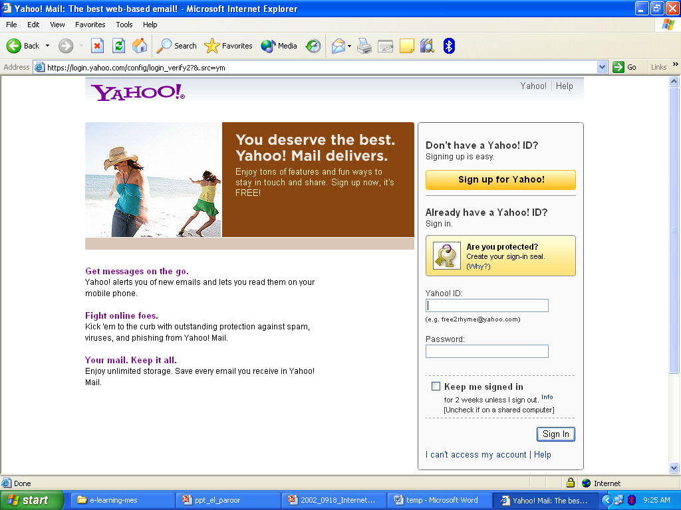

Slide 20
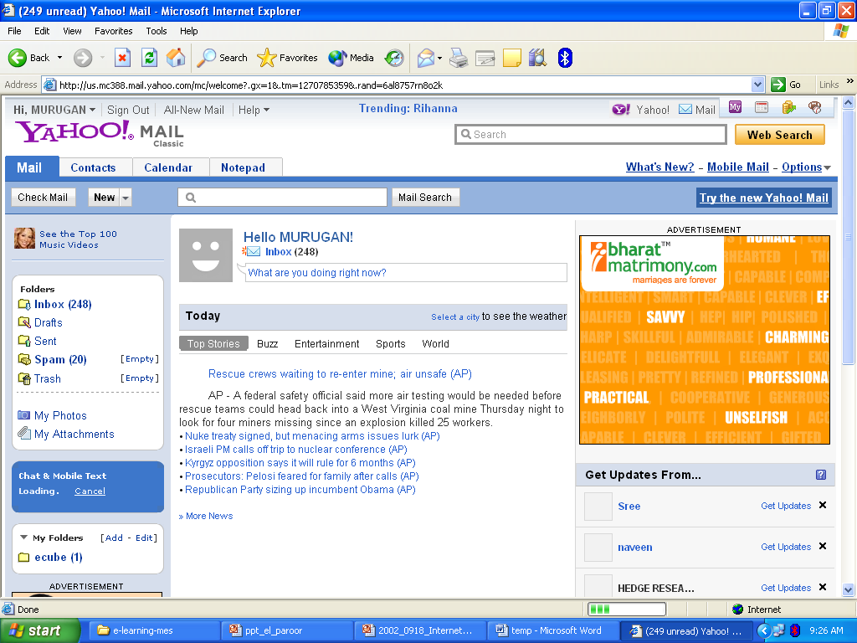

Slide 21
World Wide Web (W W W)
Most important service provided by Internet.
An internet-based hypermedia initiative for global information sharing.
Developed in 1989 by Tim Berners-Lee of the European Particle Physics Lab (CERN) in Switzerland.

Slide 22

Tim Berners-Lee
Father of W W W.
The inventor of HTML.
Invented W W W while working at CERN, the European Particle Physics Laboratory.

Slide 23
Search Engines
For searching information on the Internet.
  Google
  Yahoo
  Altavista

Slide 24
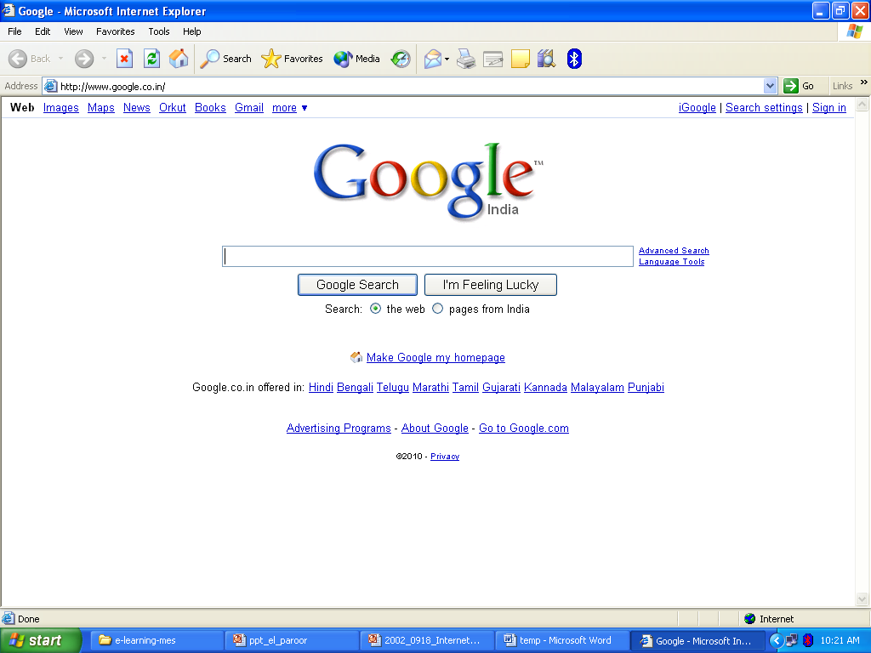

Slide 25
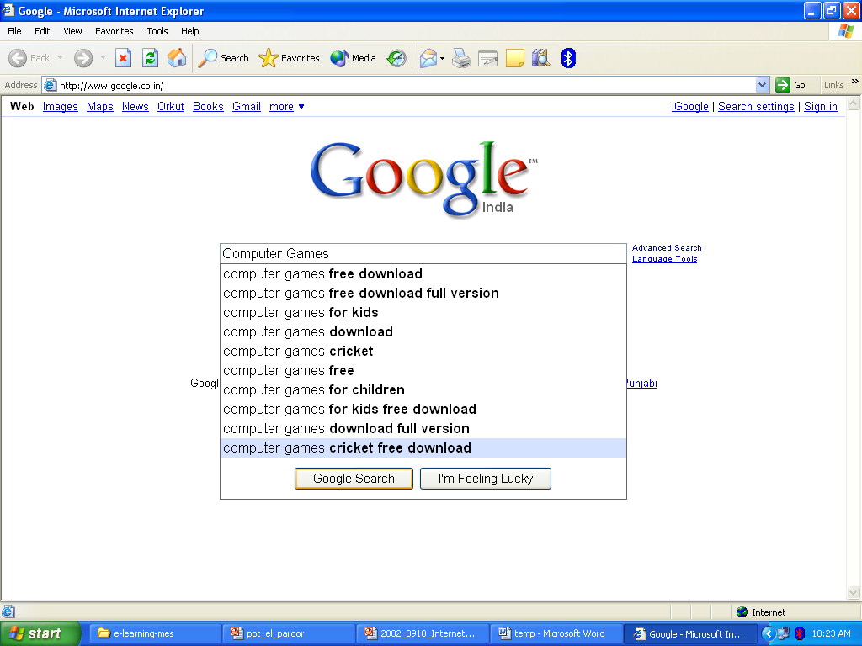

Slide 26
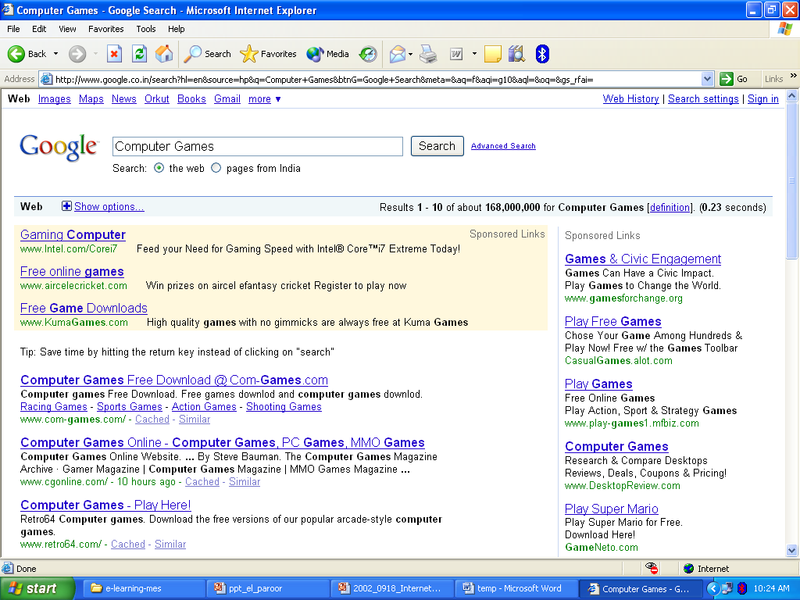

Slide 27
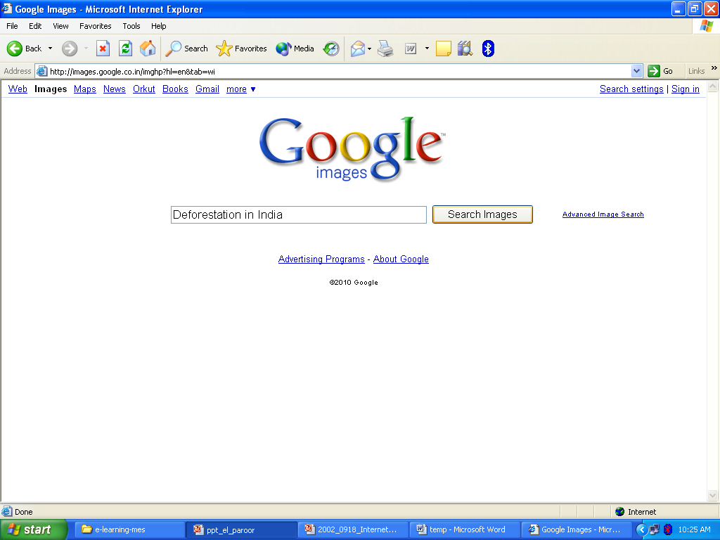

Slide 28
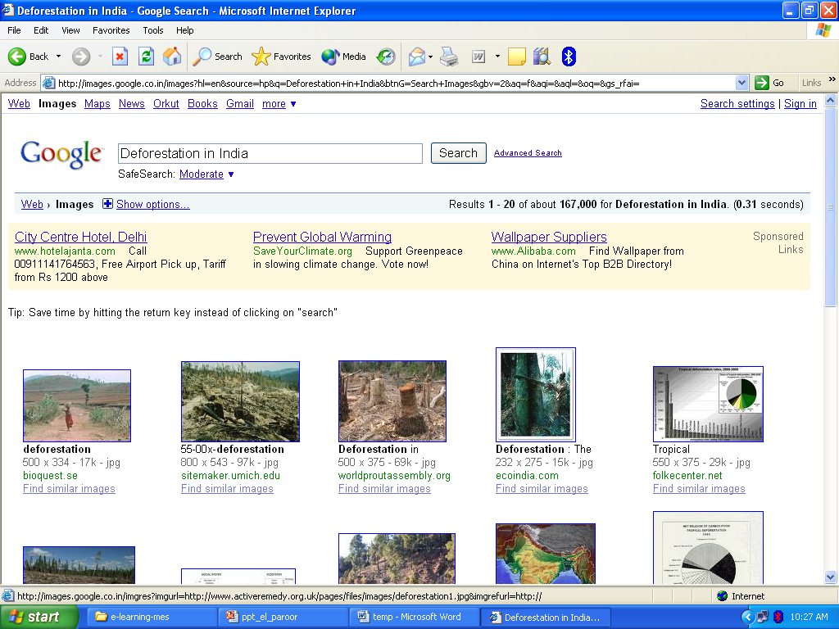

Slide 29
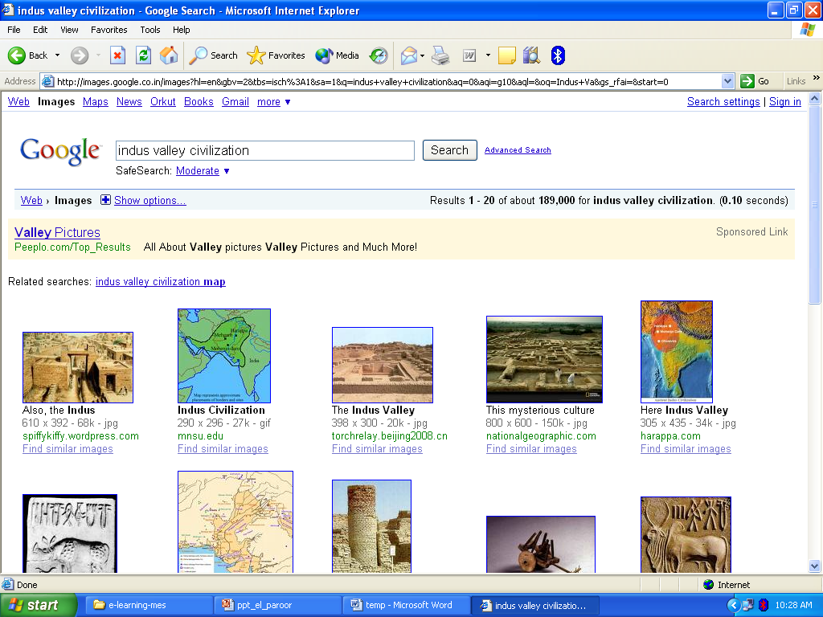

Slide 30

WIKIPEDIA
A wiki is a publishing platform on which many people can contribute new content and revise existing content.
The content benefits from the collective knowledge of the contributors, so wikis can be very beneficial for group projects.
Some businesses and organizations use wikis to maintain documents.

Slide 31
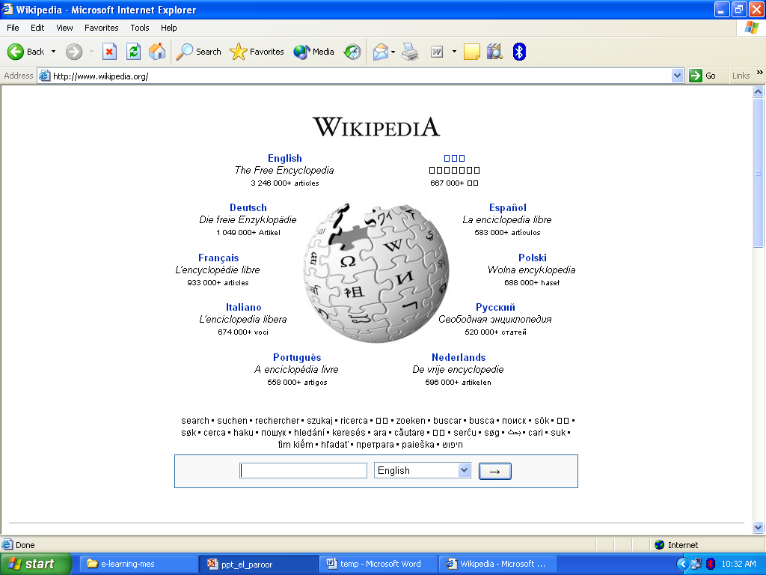

Slide 32
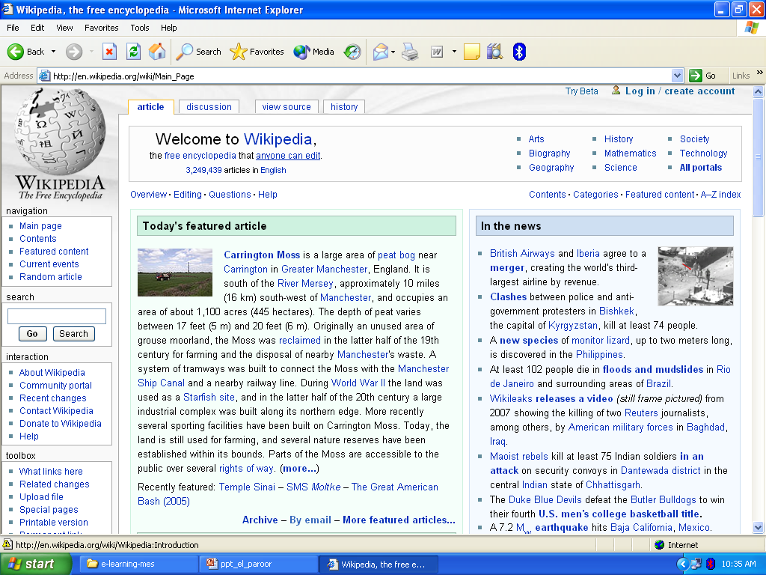

Slide 33
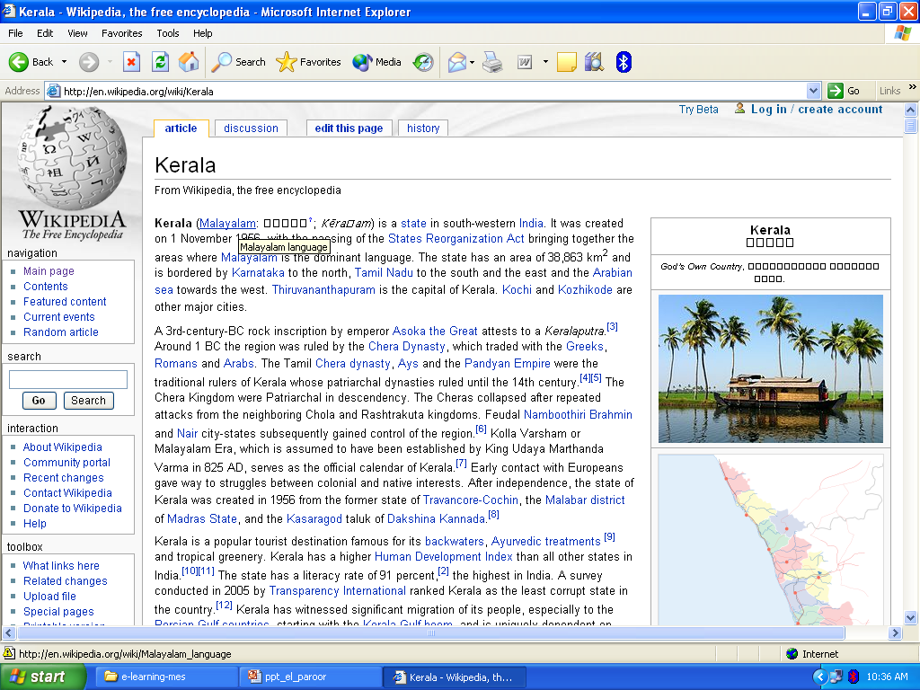

Slide 34
Impact of Internet
Education
Health Care
Business

